Slide 1

Cost Reduction through Yield Improvement
Patrick Walsh & Marcin Konieczny
26 Sept 2012

Slide 2
Project Definition
Problem Statement:
During the filtration process of bulk solutions in the Solution Prep Department, it was identified that there was a loss in volume of solution after each filtration.
This waste was occurring due to the method being used during the filtration of specific bulk sizes. (10, 20 & 50L carboys) .
Smart Goal:
Improve the filtration process by implementing a new sinker - which will minimise the amount of waste left in the 10, 20 & 50L carboy after the Bulk filtration process.
Business Excellence Department Sligo ADD

Slide 3
Process Map
Prep is manufactured in carboy & ready for filtration.
Silicone Tubing is set up for filtration process - each end of the tubing has a reducer attached.
This reducer is to help the tubing sink to the base of the container and prevent it from locking to the container wall while the peristaltic pump is in operation.
One end of the tubing is inserted into the unfiltered solution.
The other end of the tubing is fed through the peristaltic pump and attached to the filter.
During filtration, solution is drained from the carboy. It is the responsibility of the operator during this process to ensure that there is minimal waste once filtration has finished.
Because of the dimensions of the reducer used for filtration, it is not possible to extract all solution from the container.
Introduce a new sinker with smaller dimensions to replace the reducer.
This will allow the operator to access to the solution at the base of the carboy, minimizing waste
Business Excellence Department Sligo ADD

Slide 4
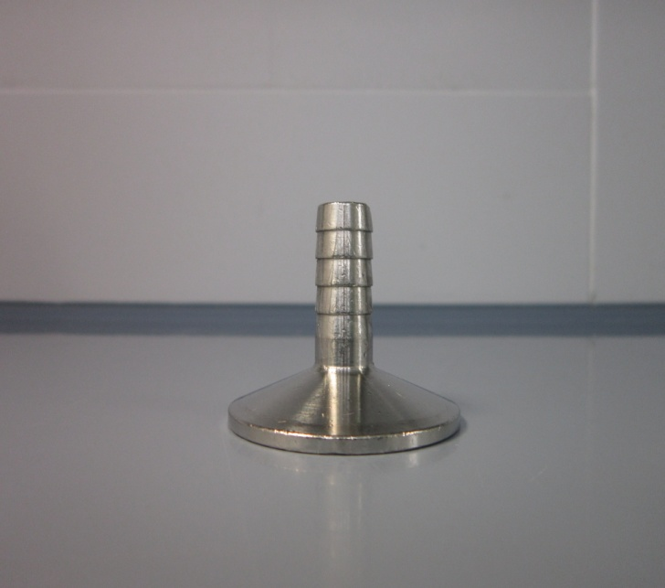
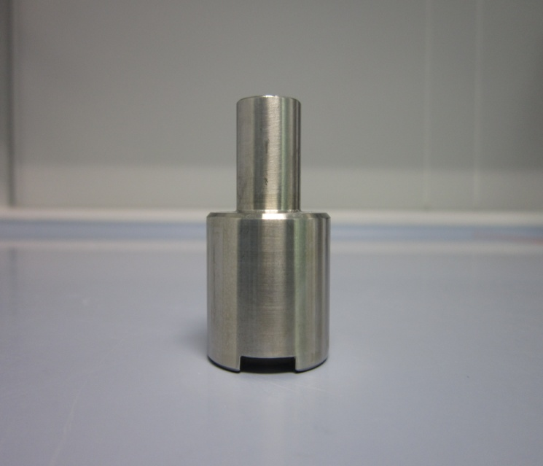
Old Sinker Vs New Sinker
Business Excellence Department Sligo ADD

Slide 5
Yellow Belt tools used during this project
Project charter
Process Map
SIPOC
Data gathering
Business Excellence Department Sligo ADD

Slide 6
SIPOC
Suppliers | Inputs | Process | Outputs | Customer
Solution Prep Department Finance Department Engineering Department Sinker Manufacturer DCC Department | Waste Measurements (phase 1 & 2) Code Price List Drawing of new sinker New Sinker Change relevant forms | Measure waste with old sinker Eliminate all irrilavant codes Place order for new sinker Provide Sinkers List new Sinker size on form | Reduce waste solution 124 codes that require filtration New Sinker listed on forms | Solution Prep Department
Business Excellence Department Sligo ADD

Slide 7
Step by Step
STEP 1
In order to measure the results of this project there were 2 measurement phases.
  The first measurement phase was conducted over 30 filtration runs using the old sinker.
  These results indicated that there was an average loss of 46.23ml of solution each time filtration was conducted.
STEP 2
Contact Finance department to obtain the current list of codes manufactured in the Solution Prep department.
  Eliminate all codes not impacted by this project – 124 codes require filtration
STEP 3
Contact engineering department for the orignal drawing of the new sinker
Order 30 new stainless steel sinkers for the Solution Prep department.
Business Excellence Department Sligo ADD

Slide 8
STEP 4
Update Forms relevant forms to list new sinker size. (Forms 01263 & 01990)
Implement new sinkers into the solution prep department.
STEP 5
The second measurement phase was also conducted over 30 filtration runs using the new sinker.
  The results of this measurement phase indicated that there was an average loss of 15.1ml of solution each time filtration was conducted.
  STEP 6
  Once all the data had been compiled it was then possible to calculate the amount of savings generated by this project.
    Formula: Cost of code x Manufacturing frequency x Volume of saved solution= total savings
Business Excellence Department Sligo ADD

Slide 9
Results & Finding
With the implementation of the new sinker we save an average of 31.1mls of solution per filtration.
This results in an annual estimated saving of €29,500.00 per annum.
Business Excellence Department Sligo ADD

Slide 10
END
Business Excellence Department Sligo ADD

